Slide 1

Sonography of Biliary ducts
By
Faculty of MIATA

Slide 2


Slide 3
ANATOMY AND PHYSIOLOGY OF THE BILE DUCTS
Bile, a vital digestive fluid, is produced by the liver.
It is composed of several key elements that aid in digestion, including bilirubin, bile acids, and cholesterol.
The function of the biliary tree is to provide a conduit for bile to drain from the liver into the small intestine (Fig. 4-1).
Bile first accumulates in the small intrahepatic biliary radicles that are located throughout the liver.
These tiny ducts are scattered throughout the liver parenchyma and are part of the portal triads.

Slide 4
ANATOMY AND PHYSIOLOGY OF THE BILE DUCTS
Each portal triad contains a small branch of the hepatic artery, portal vein, and intrahepatic duct (biliary radicle).
From these small biliary radicles, bile flows into either the right or left hepatic duct.
The right and left hepatic ducts eventually unite to form the common hepatic duct.
Bile then travels only a short distance to the gallbladder, where it is concentrated and stored.

Slide 6
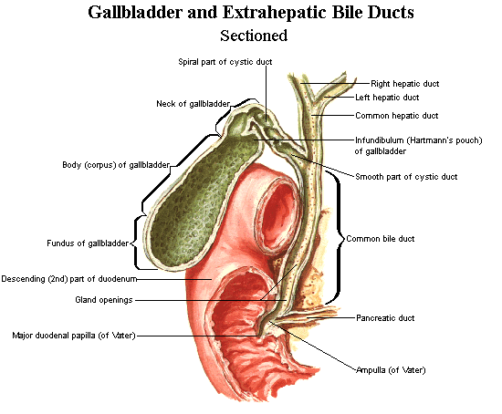

Slide 7
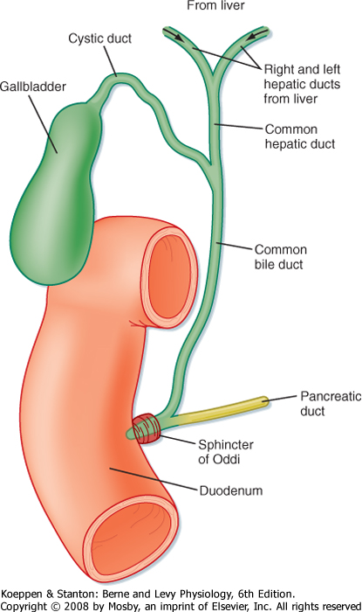

Slide 8
ANATOMY AND PHYSIOLOGY OF THE BILE DUCTS
The gallbladder is attached to the biliary tree by the cystic duct.
The point of attachment of the cystic duct to the gallbladder marks the proximal margin of the common bile duct.
The cystic duct contains tiny structures called the spiral valves of Heister.
These small projections of tissue prevent the cystic duct from collapsing or distending.

Slide 9
When stimulated by cholecystokinin, produced by the duodenum, the gallbladder contracts and empties bile into the biliary tree at the level of the proximal common bile duct.
Bile travels from the common bile duct toward the duodenum, where it meets the main pancreatic duct at the ampulla of Vater or hepatopancreatic ampulla.
There, pancreatic juices and bile are mixed together.

Slide 10
ANATOMY AND PHYSIOLOGY OF THE BILE DUCTS
The sphincter of Oddi, also referred to as the hepatopancreatic sphincter, is the opening that allows bile and pancreatic juices to flow into the duodenum.
The fluid is mixed with chyme in the duodenum and appropriate chemical reactions ensue.

Slide 11
SONOGRAPHY OF THE BILE DUCTS
Patients should have nothing to eat or drink for at least 4 hours, although a period of 8 hours is optimal, before a sonogram of the bile duct is performed.
The entire biliary tree should be examined.
Although the common bile duct can often be differentiated from the common hepatic duct if recognized posterior to the head of the pancreas or inferior to the gallbladder neck, delineation may be difficult at times.
For this reason, many sonographers and interpreting physicians may describe the portion of the biliary tree that is located at the porta hepatis as the common duct.

Slide 12
SONOGRAPHY OF THE BILE DUCTS
The normal antero-posterior diameter of the common duct in adults at the level of the porta- hepatis is between 1 and 7 mm, though clinical correlation is strongly recommended.
For patients older than age 60 or who have had a cholecystectomy, a maximum diameter of 10 mm may be considered normal if the patient is asymptomatic.

Slide 13
The “shotgun sign” or “parallel tube sign” describes the enlargement of the common duct to the size of the adjacent portal vein.
When this finding is present, color Doppler is helpful for delineating the portal vein from bile ducts.
It is important to remember that all clinical history must be considered whenever an enlarged duct is observed.

Slide 14
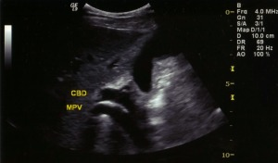
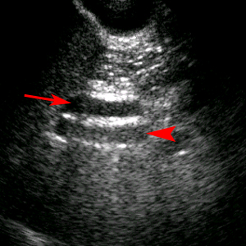

Slide 15
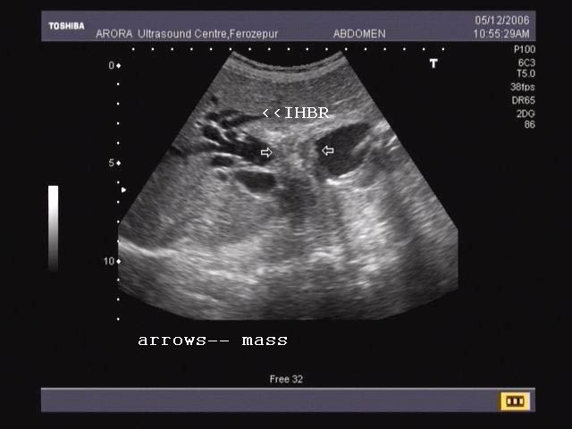

Slide 16
PATHOLOGY OF THE BILE DUCTS

Slide 17
Biliary Obstruction and Jaundice
Understanding the flow of bile from the liver to the duodenum is imperative to determine the level of biliary obstruction.
The origin of bile is within the liver, which is considered the proximal portion of the biliary tree.
Therefore, the common bile duct segment closest to the pancreatic head is considered the most distal segment of the biliary tree.
As a rule, biliary dilatation will occur proximal to the level of obstruction.
The common bile duct, the cystic duct, and part of the common hepatic duct are considered extrahepatic in location

Slide 18
Biliary Obstruction and Jaundice
All other portions of the biliary tree are considered intrahepatic.
The most common level for an obstruction to occur is the distal common bile duct.
In most instances, the extrahepatic ducts will dilate first.
Therefore, with obstruction of the distal common bile duct, there will be eventual dilatation of the common bile duct, gallbladder, common hepatic duct, and intrahepatic ducts.
The most common causes of common bile duct obstruction are choledocholithiasis, chronic pancreatitis, acute pancreatitis, and pancreatic carcinoma.

Slide 19
Biliary Obstruction and Jaundice
As a result of an obstruction within the biliary tree, the patient will eventually suffer from jaundice.
Jaundice occurs as a consequence of bilirubin accumulation within the tissues of the body.
Bilirubin, which is a yellowish pigment found in bile, can turn the skin and the whites of the eyes yellow if allowed to accumulate.
Accordingly, excessive bilirubin in the body leads to elevated serum bilirubin.
Although biliary obstruction is a common cause of jaundice, jaundice can also occur with other conditions, including hepatitis, cirrhosis, liver carcinoma, pancreatic carcinoma, and hemolytic disorders.

Slide 20
Choledocholithiasis
Whenever biliary stasis occurs, gallstone formation is probable.
Choledocholithiasis describes the presence of gallstones within the bile ducts (Fig. 4-2).
Stones typically form in the gallbladder and pass into the biliary tree.
Rarely, they can form in the ducts themselves, although some conditions increase the incidence of primary biliary tree stones.

Slide 21
Gallstones located within the common bile duct are considered the most common cause of obstructive jaundice.
Most stones will be located near the ampulla of Vater and can be difficult to image secondary to neighboring bowel gas shadows

Slide 22
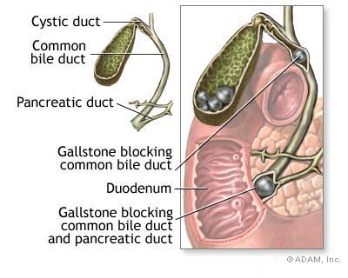
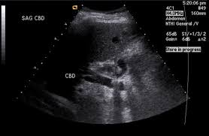

Slide 24
Choledocholithiasis
Patients with choledocholithiasis may be asymptomatic and the biliary ducts may actually be normal in caliber.
However, if biliary obstruction has occurred as a result of choledocholithiasis, the patient will have jaundice, elevated bilirubin and alkaline phosphatase, andright upper quadrant pain.
Stones located within the duct will appear as echogenic, shadowing foci; however, about 20% of the time these stones may not shadow

Slide 25
Choledocholithiasis
An uncommon manifestation of choledocholithiasis is Mirizzi syndrome.
It is a clinical condition in which the patient presents with jaundice, pain, and fever, secondary to a lodged stone in the cystic duct.
With Mirizzi syndrome, compression of the common hepatic duct is
caused by a stone located within the cystic duct.
The sonographic findings and symptoms may appear much like those found in cholecystitis.
Mirizzi syndrome may be suspected with sonography, but typically it is diagnosed by cholangiography or endoscopic retrograde cholangiopancreatography

Slide 27
Cholangitis
Inflammation of the biliary ducts is termed cholangitis.
When the bile duct walls thicken greater than 5 mm, one should suspect some form of cholangitis.
The cause of this disorder is most often some type of obstructive disease, as in the case of choledocholithiasis.

Slide 28
However, there are several types of cholangitis, including acute bacterial, AIDS, Oriental (recurrent pyogenic cholangitis), and sclerosing.
All of these have similar sonographic findings that include varying degrees of biliary dilatation, biliary sludge, and bile duct wall thickening

Slide 30
Pneumobilia
Pneumobilia is defined as air within the biliary tree.
Pneumobilia may be associated with recent biliary or gastric surgery, emphysematous or prolonged acute cholecystitis, or fistula formation.
Pneumobilia is diagnosed sonographically when echogenic linear structures are seen within the ducts (Fig. 4-3).
Air will produce ring-down artifact and have dirty shadowing.

Slide 31
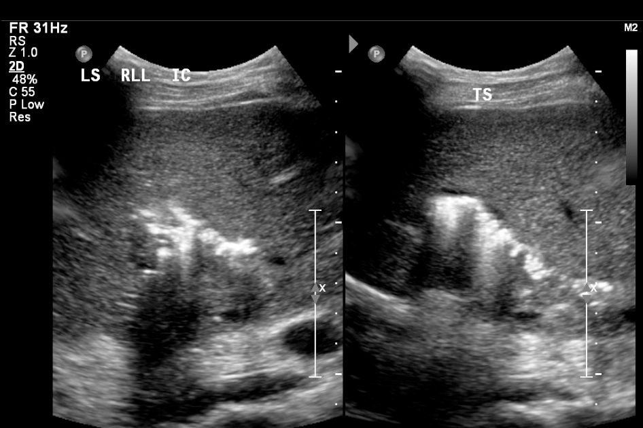

Slide 32
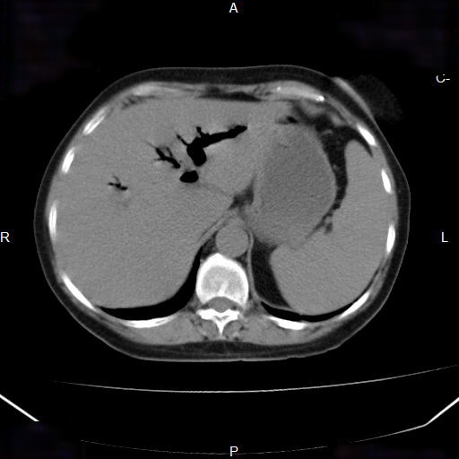

Slide 34
Cholangiocarcinoma and Klatskin Tumors
Primary biliary tree cancer is referred to as cholangiocarcinoma.
It can occur anywhere in the biliary tree.
Klatskin tumors are the most common manifestation of cholangiocarcinoma.
These tumors are located at the junction of the right and left hepatic ducts and cause dilatation of the intrahepatic ducts.
Patients will present with jaundice, pruritus, unexplained weight loss, and abdominal pain.

Slide 35
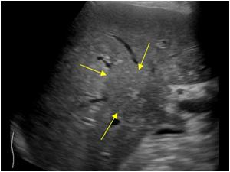
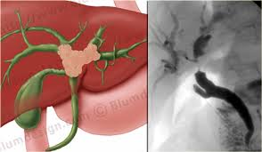

Slide 36
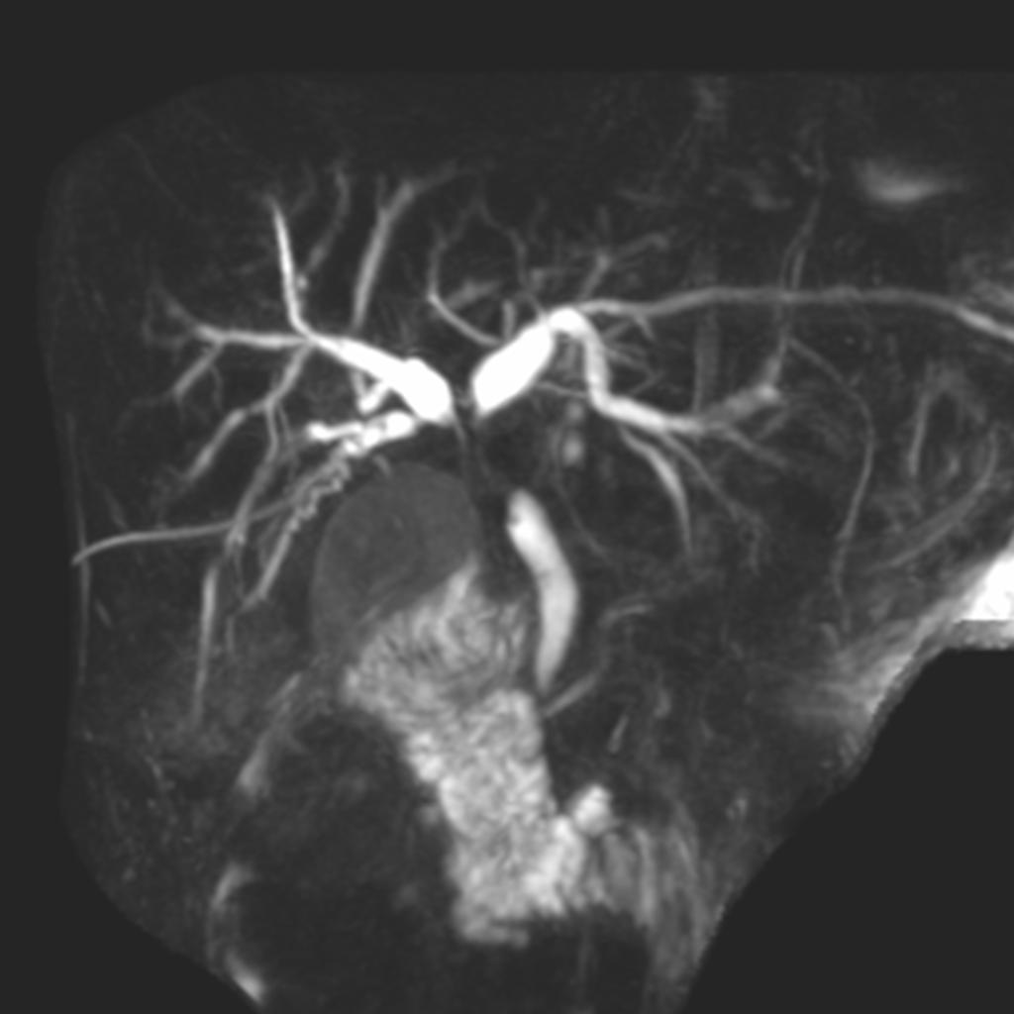

Slide 37
Cholangiocarcinoma and Klatskin Tumors
Laboratory findings include an elevated serum bilirubin.
Sonographically, dilated intrahepatic ducts that abruptly terminate at the level of the tumor are suggestive of cholangiocarcinoma (Fig. 4-4).
Occasionally, a solid mass may be noted within the liver or ducts.
Other forms of biliary cancer include squamous cell carcinoma and cystadenocarcinoma

Slide 40
PEDIATRIC PATHOLOGY OF THE BILE DUCTS

Slide 41
Biliary Atresia
Biliary atresia is a congenital disease that is thought to be caused by a viral infection at birth, although some think it may be an inherited disorder.
It is a disease with a poor prognosis that is described as the narrowing or obliteration of all or a portion of the biliary tree.
Eventually, infants suffer from cirrhosis and portal hypertension.
Sonographically, biliary atresia will appear as absent ducts.
The gallbladder may be absent as well.
Eventually, sonographic features of cirrhosis and portal hypertension will be seen.
Biliary atresia is fatal without surgical intervention

Slide 43
Choledochal Cyst
There are four different types of choledochal cysts, with the most common being described as the cystic dilatation of the common bile duct.
They are usually discovered in infancy or in the first decade of life.
Patients with a choledochal cyst present with an abdominal
mass, jaundice, pain, and fever.
Choledochal cysts can lead to cholangitis, portal hypertension, pancreatitis, and liver failure.
Sonographic findings of a choledochal cyst include a fusiform cystic mass in the area of the porta hepatis and biliary dilatation (Fig. 4-5).

Slide 44
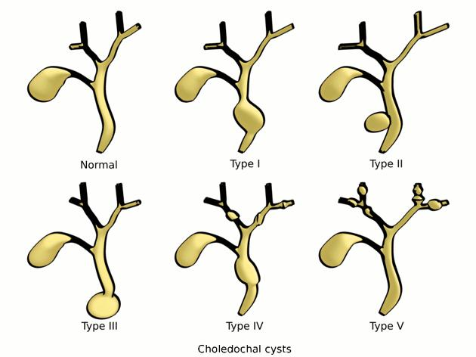

Slide 45
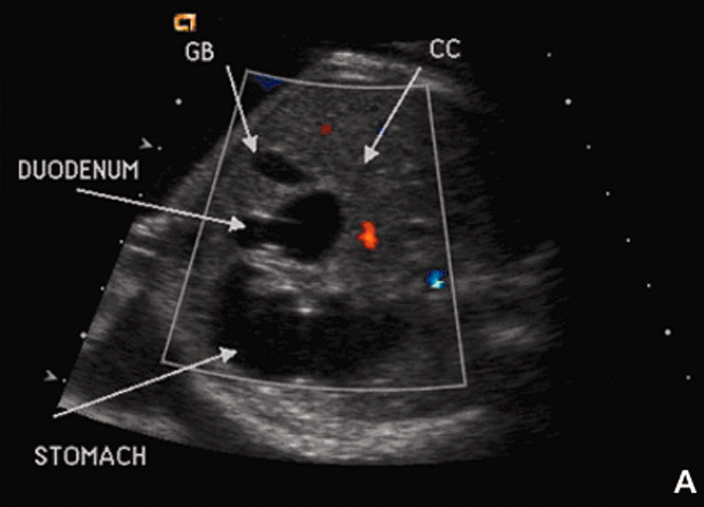

Slide 46
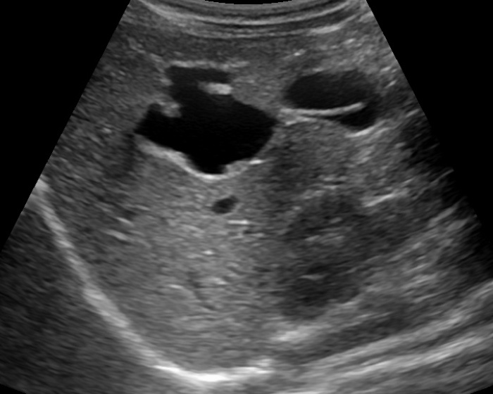

Slide 47
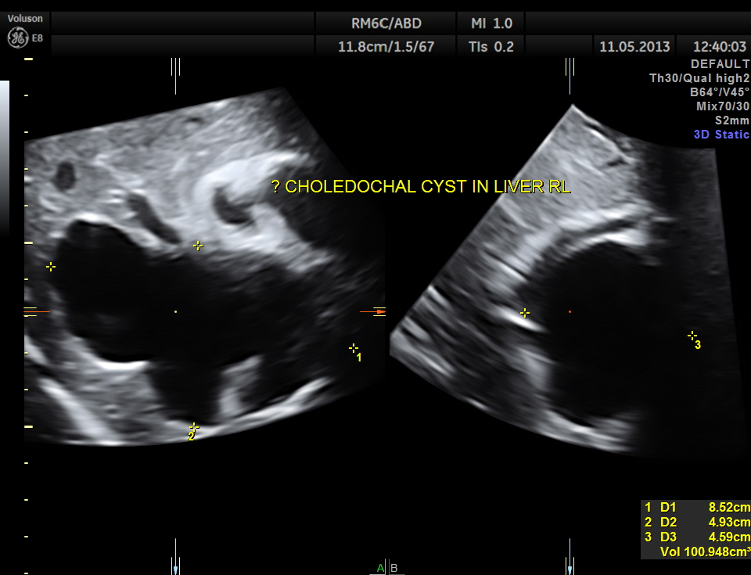

Slide 49
Caroli Disease
Caroli disease, or Caroli syndrome, is a congenital disorder characterized by segmental dilatation of the intrahepatic ducts.
It is often seen in association with cystic renal disease and may precede the development of cholangiocarcinoma, a hepatic abscess, cholangitis, and sepsis.

